Slide 1
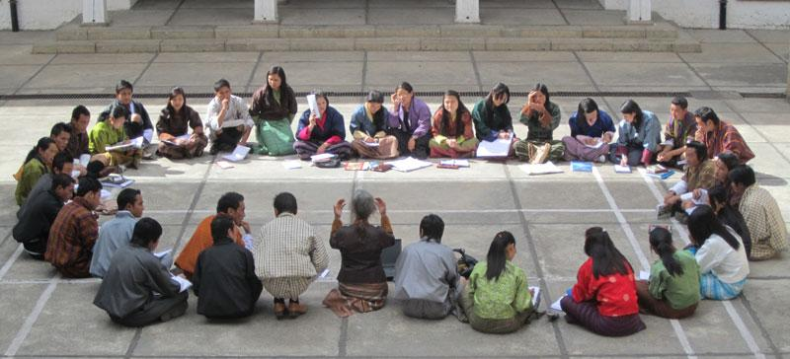
Catching Everyone Up
If you are caught up,
help your neighbor

Slide 2


Slide 3

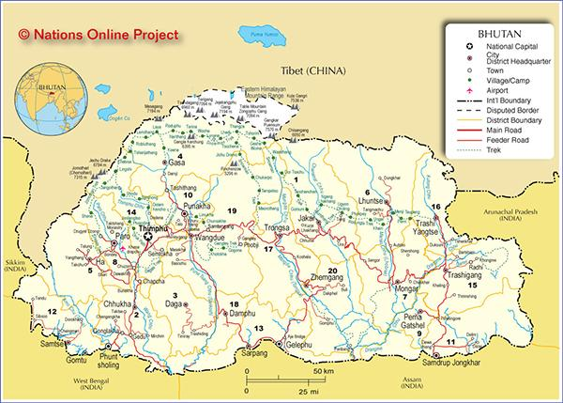
Bhutanese Children

Slide 4



Slide 5

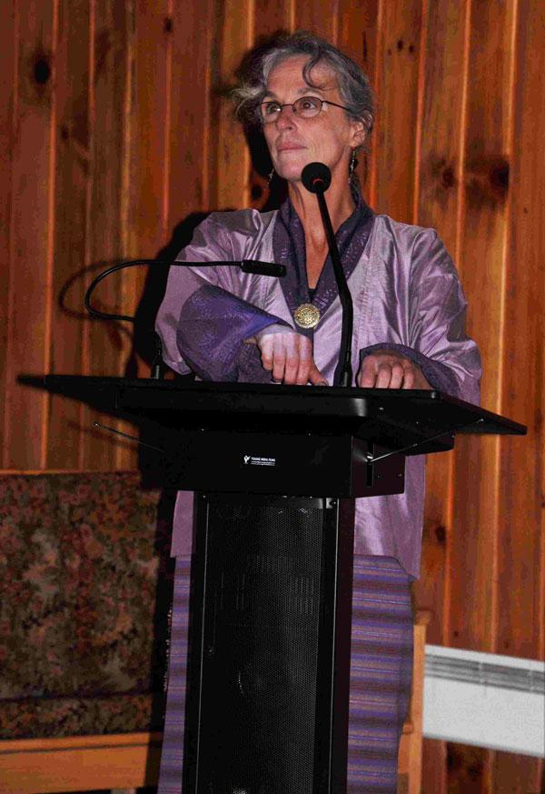
Male Traditional
Clothes: Gho
Female Traditional
Clothes: Kira

Slide 6
Review, Road map to the future
Minimal Installation
USB Installation
Cobbler Network Installation
Network Installation HeavyWeight Kickstart
Network Installation Lightweight (Minimal) Kickstart
Puppet Configuration
Still two missing pieces:
Hiera data - Custom data for nodes
Templates - Generic Files with variable substitution
Installation Restore/Reproduce
Re-install back to where we came
Shared File System
Have seen NFS Client need to look at NFS server
Other file options: Hadoop, CVMFS, etc
Distributed Computing
HTCondor
Other options: SLURM, PBS/Torque, etc

Slide 7
HTCondor Daemons
An HTCondor pool is a collection of machines that receive, schedule and run jobs.
Your two node cluster is an HTCondor poole.
HTCondor distributes its functionality between daemon:
condor_master: This daemon's role is to simplify system administration by keeping the rest of the Condor daemons running.
condor_startd: Enables a machine to execute jobs.
condor_schedd: This daemon sends jobs to the Condor pool for execution.
condor_collector: This daemon is responsible for collecting all the information about the status of a Condor pool in particular pending requests.
condor_negotiator: Matches pending requests with available resources.

Slide 8
Example HTCondor Hosts:
Condor Master Server | Condor Submit | Condor Execute
condor_master condor_schedd condor_collector condor_negotiator (condor_startd) | condor_master condor_schedd (condor_startd) | condor_master condor_startd (condor_schedd)
Daemons are defined in /etc/condor/config.d/99_local.conf:
DAEMON_LIST = MASTER, COLLECTOR, NEGOTIATOR, SCHEDD, STARTD
Optional daemons are in parenthesis.

Slide 9
The HTCondor configuration files are in:
/etc/condor/config.d/
IMPORTANT:
The HTCondor Master Node is defined in:
/etc/condor/config.d/95-cluster.config
CONDOR_HOST = HTCONDOR_SERVER_IP
For our 2 node “pool”s, both use the IP ADDRESS of the server
The parameters in 92-multi-core.config allow jobs to request more than one core.
See section on submitting jobs for actually requesting >1 core

Slide 10
Submiting HTCondor Jobs
Jobs are submitted to HTCondor using an HTCondor Job Resource File.
The Job Resource File defines:
What will run and any command line arguments
Optional input/output files
Files to transfer to execution host
Files to return to submitter from execution host
Any special requests: Number of cores, memory and/or disk requirements, etc

Slide 11
HTCondor Example Resource File:
Executable = TestJob Universe = vanilla Output = /tmp/CondorTestJob.$(Cluster).$(Process).out Error = /tmp/CondorTestJob.$(Cluster).$(Process).err Log = /tmp/CondorTestJob.$(Cluster).$(Process).log ShouldTransferFiles = YES WhenToTransferOutput = ON_EXIT TransferInputFiles = Prime request_cpus = 2 Queue
${Cluster} and ${Process} are job assigned numbers.

Slide 12
Executable = TestJob Universe = vanilla Output = /tmp/CondorTestJob.$(Cluster).$(Process).out Error = /tmp/CondorTestJob.$(Cluster).$(Process).err Log = /tmp/CondorTestJob.$(Cluster).$(Process).log ShouldTransferFiles = YES WhenToTransferOutput = ON_EXIT TransferInputFiles = Prime request_cpus = 2 Queue | Executable to run Condor Universe STDOUT STDERR LOG File Transfer File = True At End of Job Output to transfer Run on 2 cores Always last statement
Condor Universe - Vamilla is always used for shell scripts.
See: Condor Manual - Vanilla Universe

Slide 13
Condor User Commands:
Use the following commands:
condor_q - Print a list of jobs in the queue
condor_status - Print a list of the current execution hosts/slots
condor_rm - Remove job from the queue
condor_history - Print job history
There are many other HTCondor commands.

Slide 14
Class 11 Agenda: Date April 5, 2018 Objective: Having Everyone Finish the Last Two Classes Configuration for Full Client Reboot/Restore Saving Host ssh keys and restoring Saving Puppet Client certificates and Restoring HTCondor Installation Running First HTCondor Job
Class 11 Slides:
In-class documentation: No new documentation for this class Please consult:
Class 7 - Introduction NFS and autofs
Class 8 - Writing Your First Puppet Module
Class 9 - User/Host ssh keys and more
In class problem - Putting it all together
Class 10 - Running Jobs on Distributed Systems

